Slide 1
Arduino Lab 6 : Motor
Asst. Prof. Dr.Sumek Wisayataksin
Faculty of Engineering
King Mongkut’s Institute of Technology Ladkrabang

Slide 2
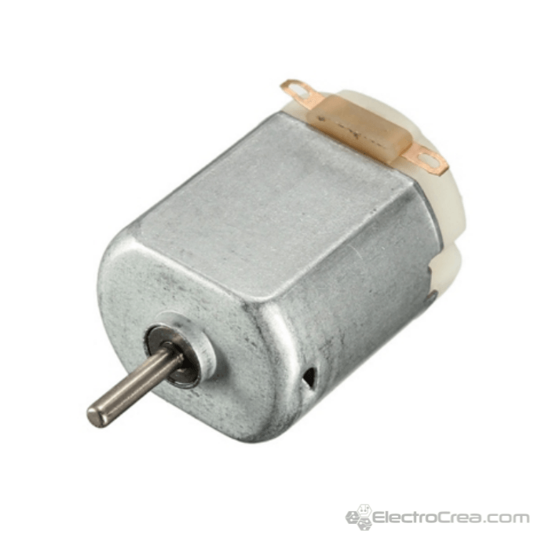
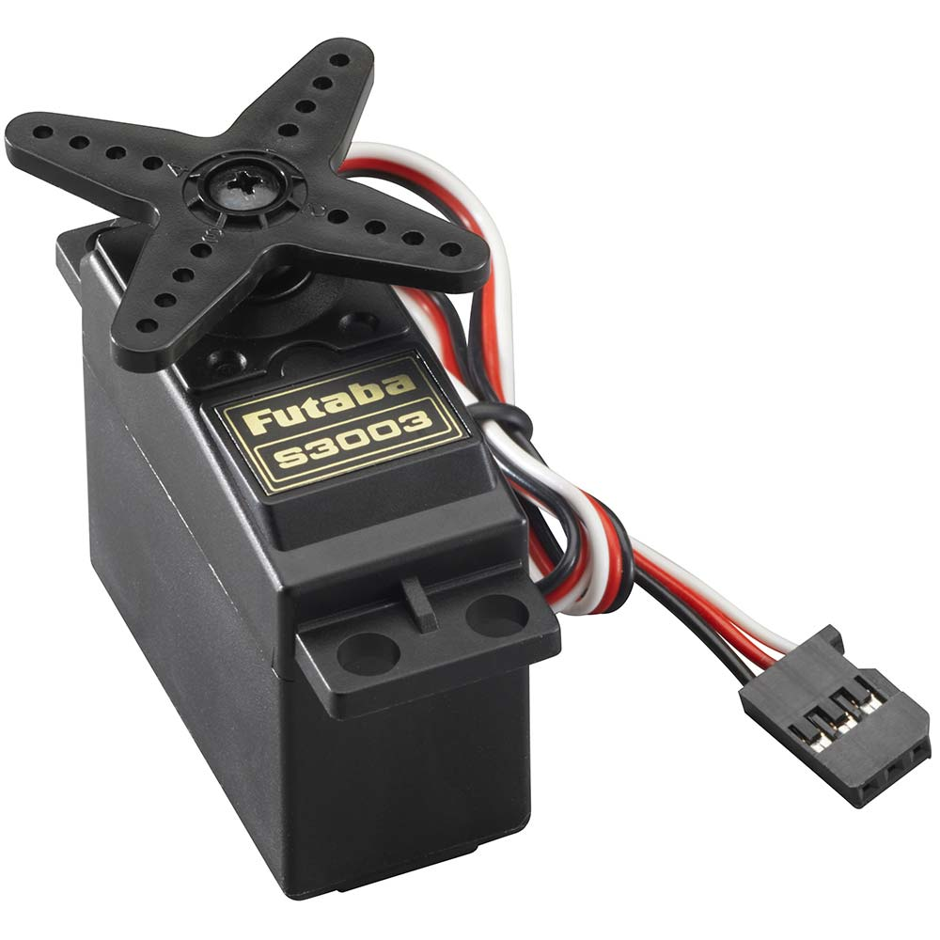
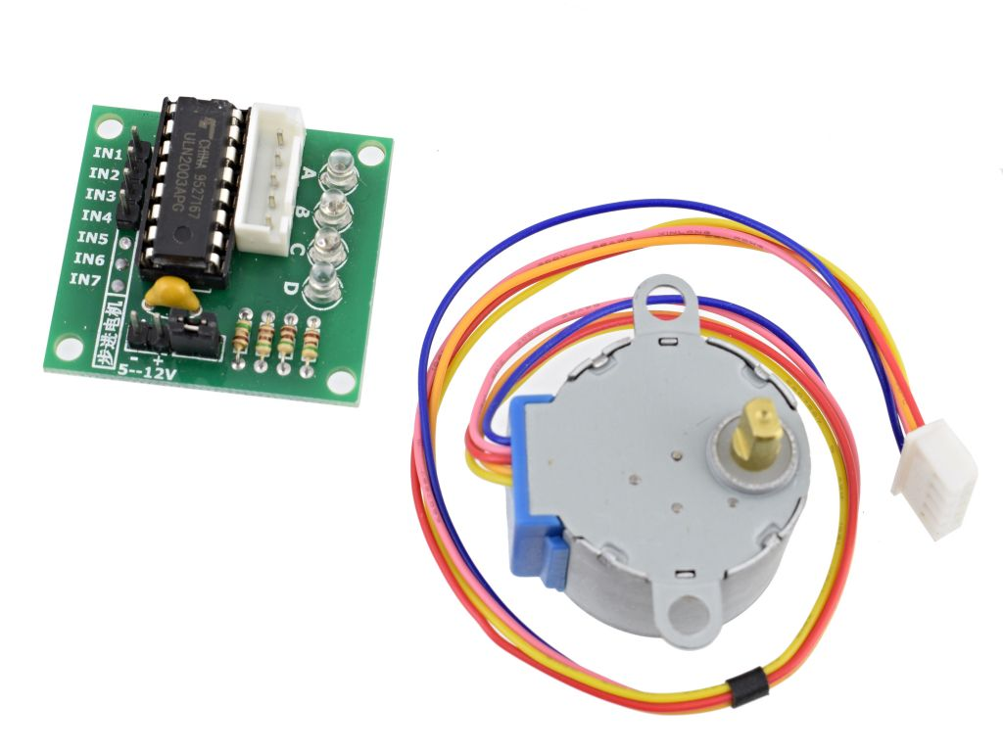
Motor
Servo Motor. Stepper Motor. DC Motor.

Slide 3
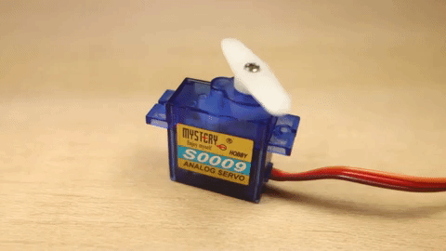
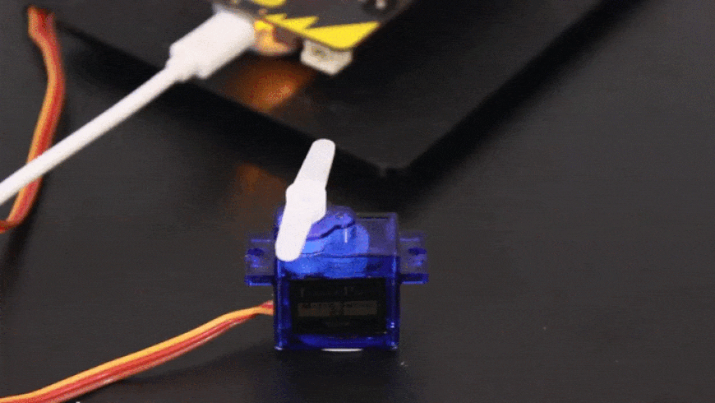
Servo Motor
A servo-motor is an actuator with a built-in feedback mechanism that responds to a control signal by moving to and holding a position, or by moving at a continuous speed.

Slide 4
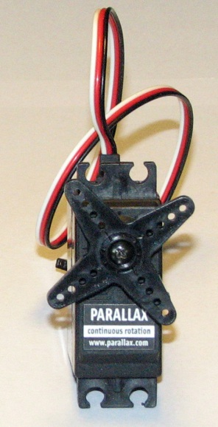
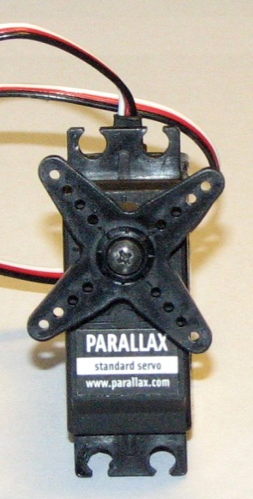
Servo Motor
Two types of servos
continuous rotation
standard
can rotate all the way around in either direction
can only rotate 180 degrees
pulse tells servo
which way to spin & how fast to spin
pulse tells servo
which position to hold

Slide 5
Servo Motor
How to control the angle
Pulse frequency is fixed
Typical: 20 ms
Pulse width determines position
Typical: 1ms to 2 ms

Slide 6
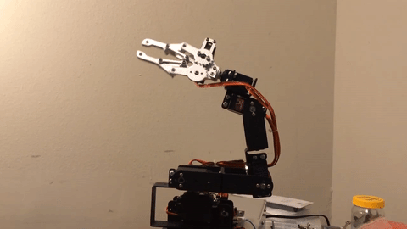

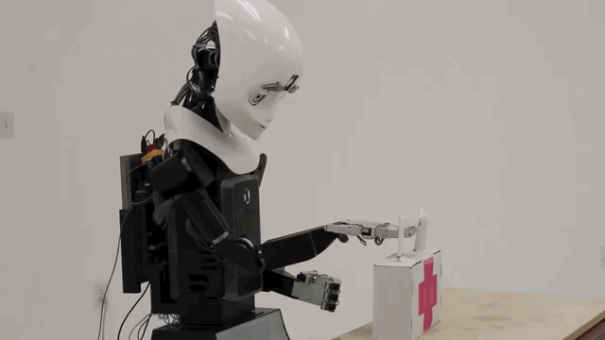
Servo Motor
Application

Slide 7
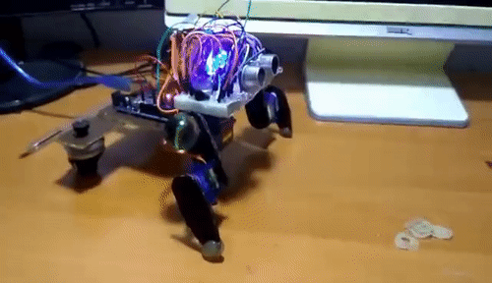
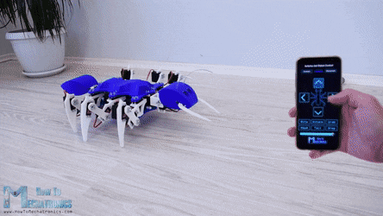
Servo Motor
Application

Slide 8
Servo Motor
Connection

Slide 9
Servo Motor
Arduino Servo library
Three components of the Servo Library
Create the servo object
Servo my_servo_object;
Attach the object
my_servo_object.attach(servo_pin);
Send control signal
my_servo_object.write(pos);
Name of the object is like a variable name.
attach and write are pre-defined methods that act on the servo object.

Slide 10
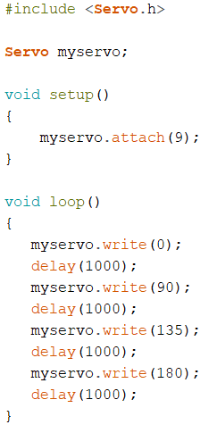
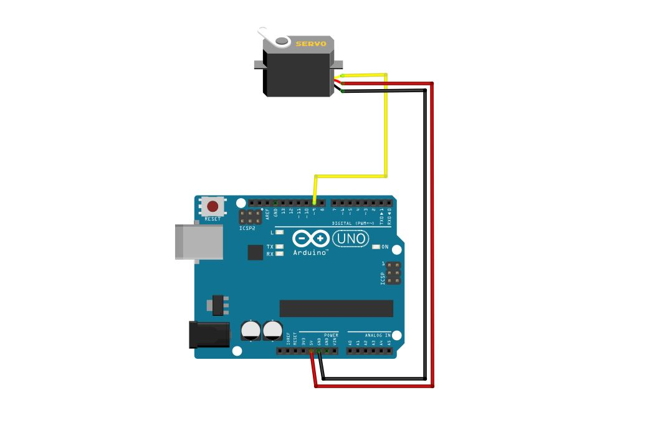
Servo Motor
Servo Motor Code Sample
White Pin

Slide 11

Lab 6.1 : Servo Motor
Control Servo motor using push button.
Angle starts at 0 degree. Every time button is pushed, angle increases 45 degree.
When angle become 180 degree, decrease 45 degree until 0 degree.
Show the angle on Serial port.
0 -> 45 -> 90 -> 135 -> 180 -> 135 -> 90 -> 45 -> 0 > ….
White Pin

Slide 12
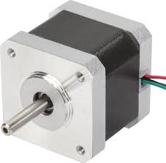
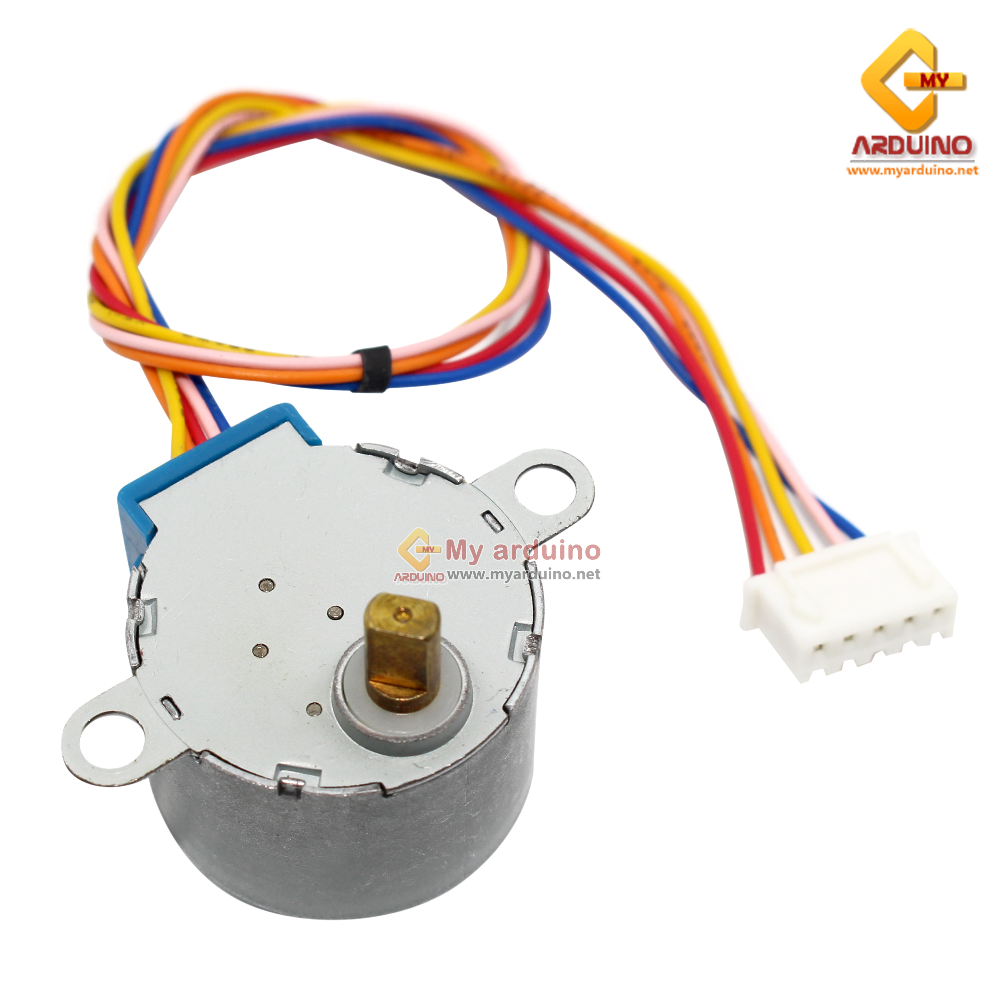
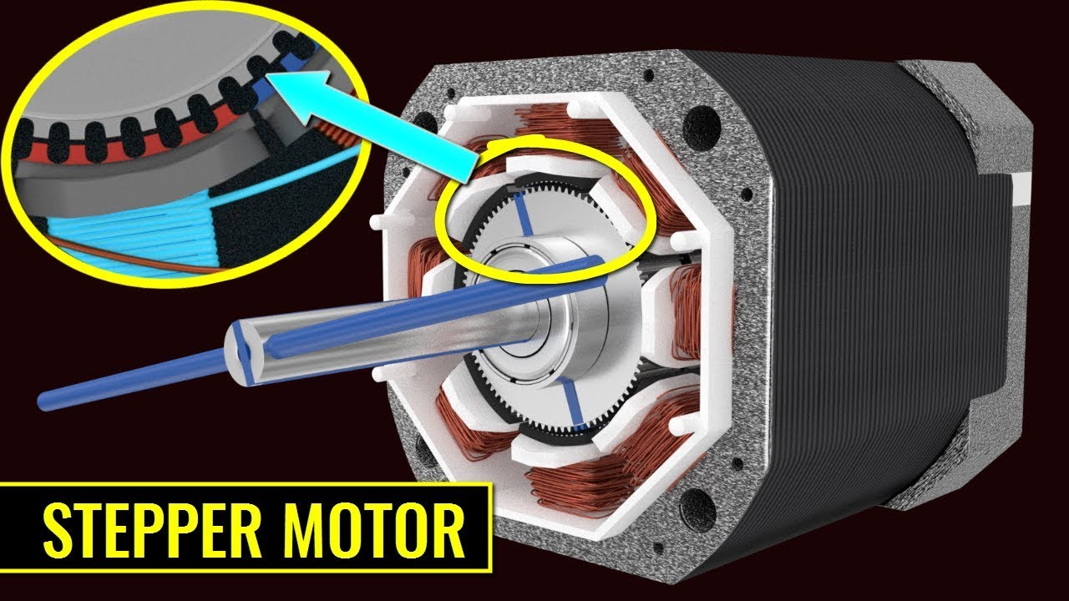
Stepper Motor
DC motors with precise control of how far they spin.
They have a fixed number of “steps” the take to turn one full revolution.
You can control them one step at a time.
Makes for very precise and repeatable positioning.

Slide 13
Stepper Motor
Very precise.
Much stronger than servos, but they use more current.
a little tricky to drive.

Slide 14
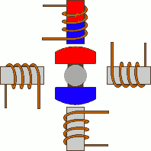
Stepper Motor
How do they work ?
in1
FULL STEP
in2
 | in1 | in2 | in3 | In4
Phase 1 | 1 | 0 | 0 | 0
Phase 2 | 0 | 1 | 0 | 0
Phase 3 | 0 | 0 | 1 | 0
Phase 4 | 0 | 0 | 0 | 1
in4
in3

Slide 15
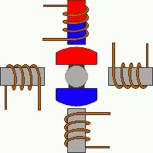
Stepper Motor
How do they work ?
HALF STEP
in1
 | in1 | in2 | in3 | In4
Phase 1 | 1 | 0 | 0 | 0
Phase 2 | 1 | 1 | 0 | 0
Phase 3 | 0 | 1 | 0 | 0
Phase 4 | 0 | 1 | 1 | 0
Phase 5 | 0 | 0 | 1 | 0
Phase 6 | 0 | 0 | 1 | 1
Phase 7 | 0 | 0 | 0 | 1
Phase 8 | 1 | 0 | 0 | 1
in2
in4
in3

Slide 16
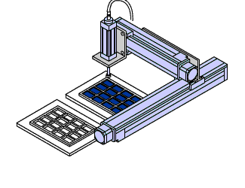
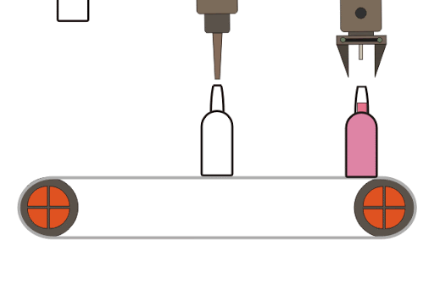
Stepper Motor
Applications

Slide 17
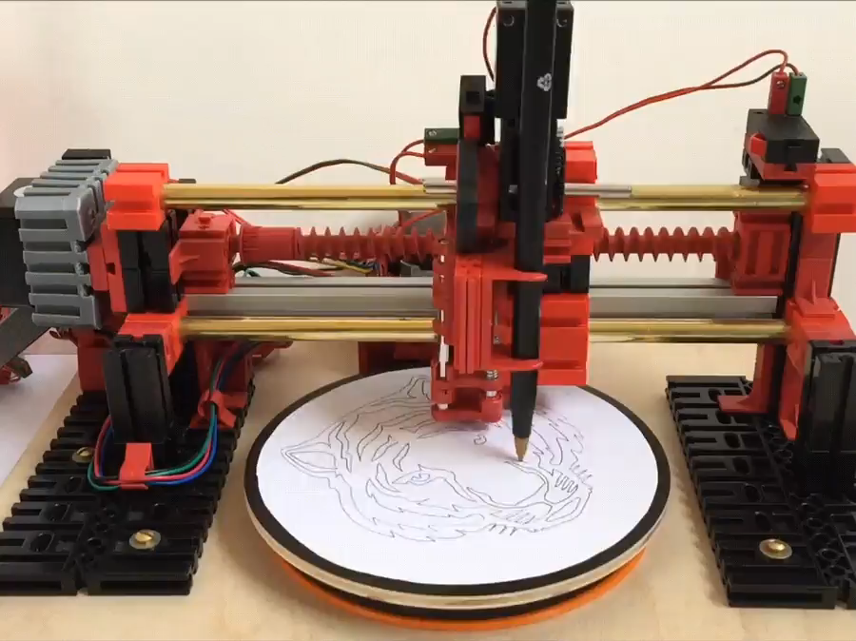
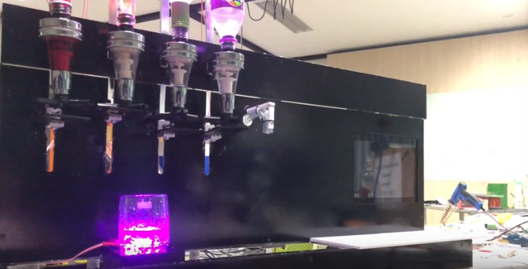
Stepper Motor
Applications

Slide 18
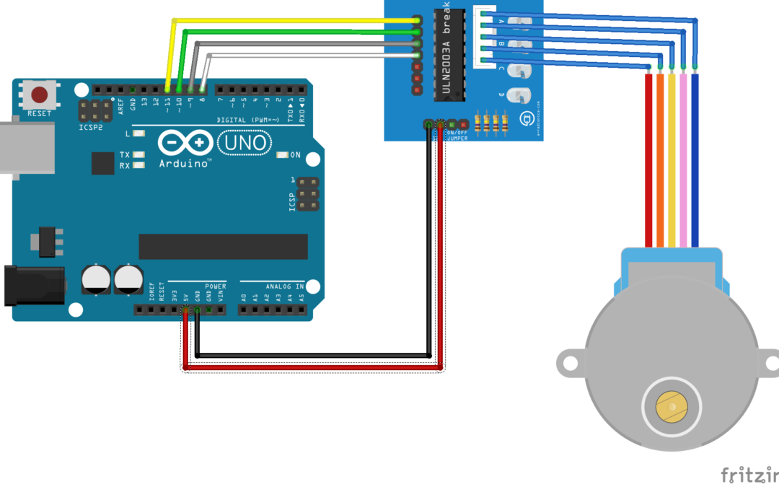
Lab 6.2 : Stepper Motor
Connection

Slide 19
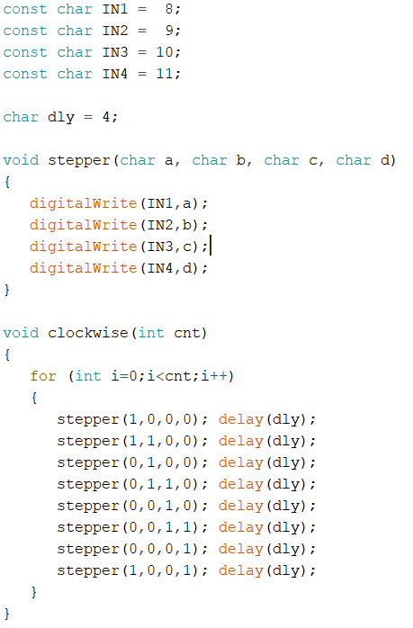
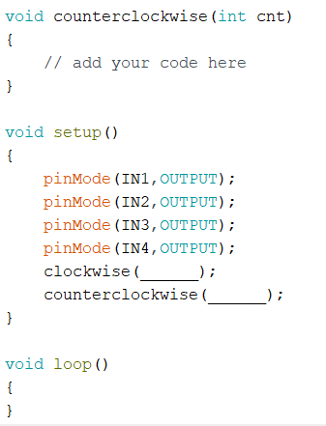
Lab 6.2 : Stepper Motor
Code
Find a number to make the stepper motor turns
360, 180, 90 and 45 degree

Slide 20
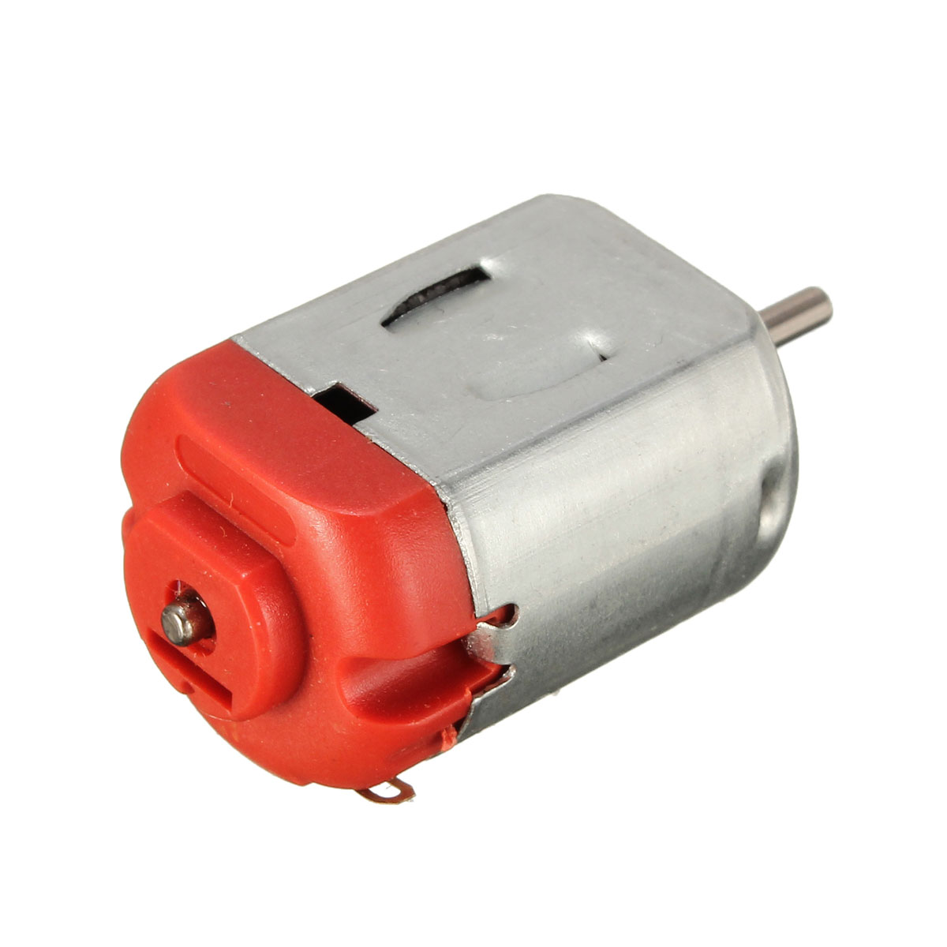
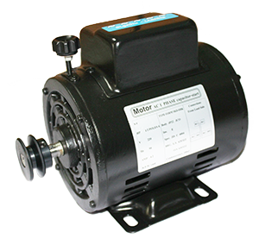
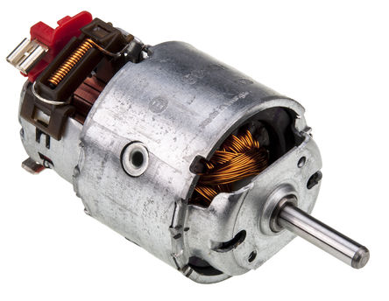
DC Motor
It is a machine which convert electrical energy into mechanical energy.
DC motor means a motor that runs on direct current (DC) electricity.

Slide 21
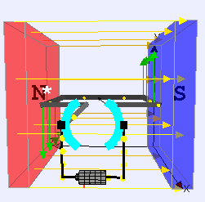
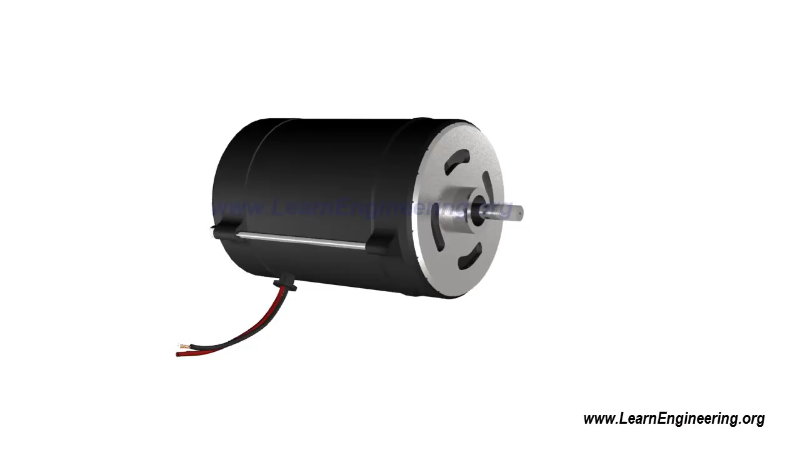
DC Motor
How do they work ?

Slide 22
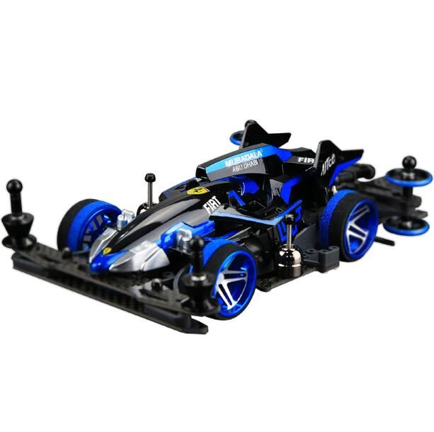

DC Motor
Application

Slide 23
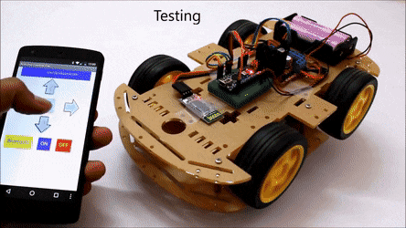
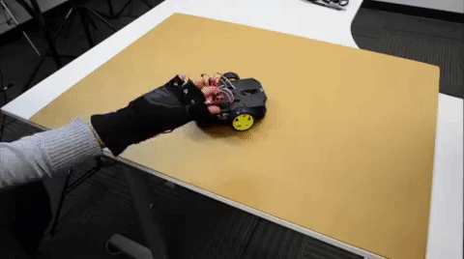
DC Motor
Applications

Slide 24
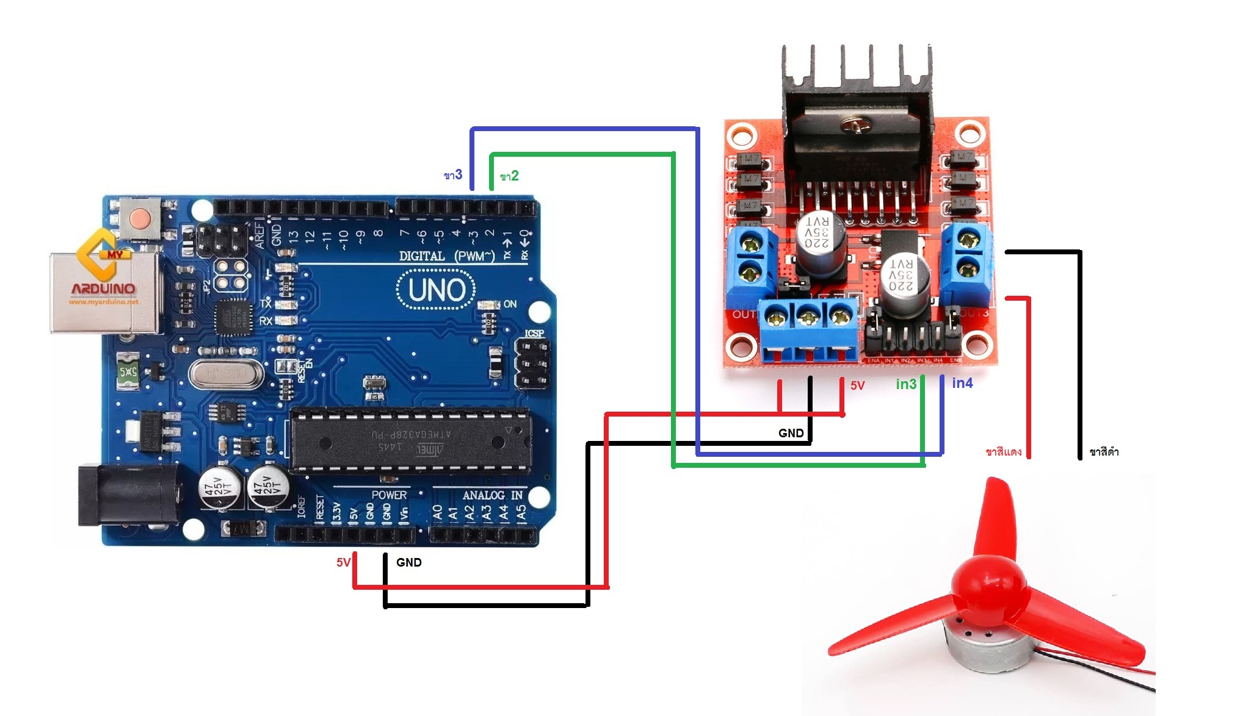
DC Motor
Connection
3
2
Use Adapter for high power

Slide 25
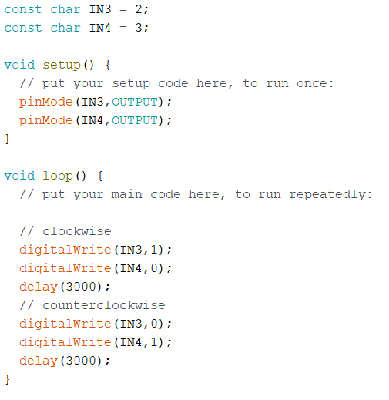
DC Motor
Sample Code

Slide 26
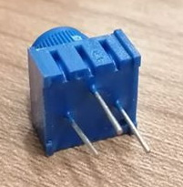
Lab 6.3 DC Motor
3
1
2

Slide 27
Lab 6.3 DC Motor
Control DC motor speed using “analogWrite”.
Speed control from potentiometer (leftmost -> stop, rightmost -> fastest)
Push button is used to change the direction (clockwise -> counterclockwise -> clockwise).
Showing spin direction and speed in percent in a serial monitor.
clockwise 30%
Example

